Slide 1

Data Mining
CS-772
Department of
Computer Sciences

Slide 2
Clustering
Adapted from Web Data Mining. Bing Liu

Slide 3
Clustering
Clustering is a technique for finding similarity groups in data, called clusters. I.e.,
it groups data instances that are similar to (near) each other in one cluster and data instances that are very different (far away) from each other into different clusters.
Clustering is often called an unsupervised learning task as no class values denoting an a priori grouping of the data instances are given, which is the case in supervised learning.

Slide 4
Real-life examples
Example 1: groups people of similar sizes together to make “small”, “medium” and “large” T-Shirts.
Tailor-made for each person: too expensive
One-size-fits-all: does not fit all.
Example 2: In marketing, segment customers according to their similarities
To do targeted marketing.
Example 3: Given a collection of text documents, we want to organize them according to their content similarities,
To produce a topic hierarchy
In fact, clustering is one of the most utilized data mining techniques.

Slide 5
Benefits
In an economics application we might be interested in finding countries whose economies are similar.
In a financial application we might wish to find clusters of companies that have similar financial performance.
In a marketing application we might wish to find clusters of customers with similar buying behavior.
In a medical application we might wish to find clusters of patients with similar symptoms.
In a document retrieval application we might wish to find clusters of documents with related content.
In a crime analysis application we might look for clusters of high volume crimes such as burglaries or try to cluster together much rarer (but possibly related) crimes such as murders.

Slide 6
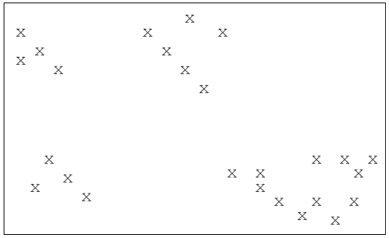
Clusters
In the restricted case where each object is described by the values of just two attributes, we can represent them as points in a two-dimensional space (a plane) such as

Slide 7
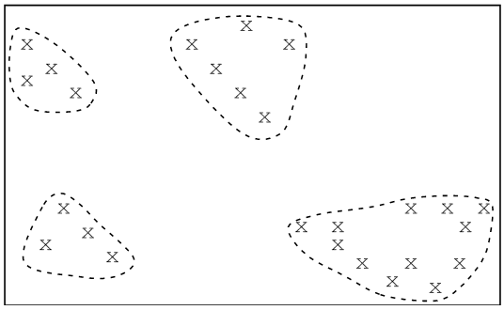
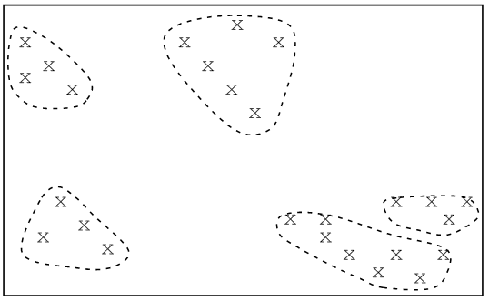
There is frequently more than one possibility!

Slide 8
Attributes - Dimensions
In the case of three attributes we can think of the objects as being points in a three-dimensional space (such as a room) and visualizing clusters is generally straightforward too.
For larger dimensions (i.e. larger numbers of attributes) it soon becomes impossible to visualize the points, far less the clusters.

Slide 9
Distance Based Clustering
Before using a distance-based clustering algorithm to cluster objects, it is first necessary to decide on a way of measuring the distance between two points.
As for nearest neighbor classification, discussed in K-NN technique, a measure commonly used when clustering is the Euclidean distance.
we will assume that all attribute values are continuous.
We next need to introduce the notion of the ‘center’ of a cluster, generally called its centroid.

Slide 10
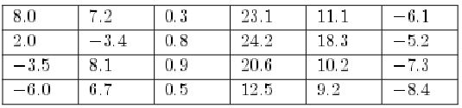
Centroid
Assuming that we are using Euclidean distance or something similar as a measure we can define the centroid of a cluster to be the point for which each attribute value is the average of the values of the corresponding attribute for all the points in the cluster.
So the centroid of the four points (with 6 attributes)
would be
Notes:
The centroid of a cluster will sometimes be one of the points in the cluster,
but frequently, as in the above example, it will be an ‘imaginary’ point, not
part of the cluster itself, which we can take as marking its centre.

Slide 11
Methods of Clustering
The most commonly used:
k-means clustering
hierarchical clustering

Slide 12
K-Means Clustering
We start by deciding how many clusters we would like to form from our data.
We call this value k, such as 2, 3, 4 or 5, but may be larger.
We next select k points (generally corresponding to the location of k of the objects).
These are treated as the centroids of k clusters, or to be more precise as the centroids of k potential clusters, which at present have no members.
We can select these points in any way we wish, but the method may work better if we pick k initial points that are fairly far apart.

Slide 13
K-Means Clustering
We now assign each of the points one by one to the cluster which has the nearest centroid.
When all the objects have been assigned we will have k clusters based on the original k centroids.
The ‘centroids’ will no longer be the true centroids of the clusters.
Next we recalculate the centroids of the clusters, and then repeat the previous steps, assigning each object to the cluster with the nearest centroid etc.

Slide 14
Algorithm
1. Choose a value of k.
2. Select k objects in an arbitrary fashion. Use these as the initial set of k centroids.
3. Assign each of the objects to the cluster for which it is nearest to the centroid.
4. Recalculate the centroids of the k clusters.
5. Repeat steps 3 and 4 until the centroids no longer move.

Slide 15
Objective Function
We can measure the quality of a set of clusters using the value of an objective function
Which we can take to be the sum of the squares of the distances of each point from the centroid of the cluster to which it is assigned.
We would like the value of this function to be as small as possible.

Slide 16
Strengths of k-Means Clustering
Simple: easy to understand and to implement
Efficient: Time complexity: O(tkn),
where n is the number of data points,
k is the number of clusters, and
t is the number of iterations.
Since both k and t are small. k-means is considered a linear algorithm.

Slide 17
Weaknesses of k-means
The algorithm is only applicable if the mean is defined.
For categorical data, k-mode - the centroid is represented by most frequent values.
The user needs to specify k.
The algorithm is sensitive to outliers
Outliers are data points that are very far away from other data points.
Outliers could be errors in the data recording or some special data points with very different values.

Slide 18
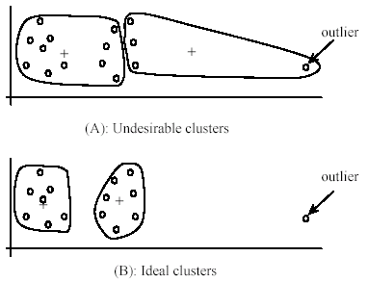
Weaknesses of k-means

Slide 19
Weaknesses of k-means: To deal with outliers
One method is to remove some data points in the clustering process that are much further away from the centroids than other data points.
To be safe, we may want to monitor these possible outliers over a few iterations and then decide to remove them.
Another method is to perform random sampling. Since in sampling we only choose a small subset of the data points, the chance of selecting an outlier is very small.
Assign the rest of the data points to the clusters by distance or similarity comparison, or classification

Slide 20
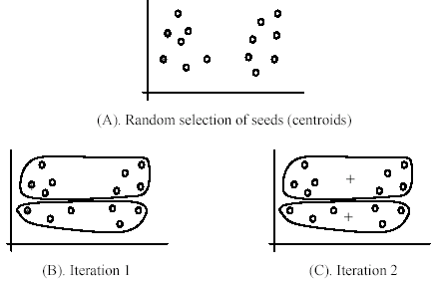
The algorithm is sensitive to initial seeds.

Slide 21
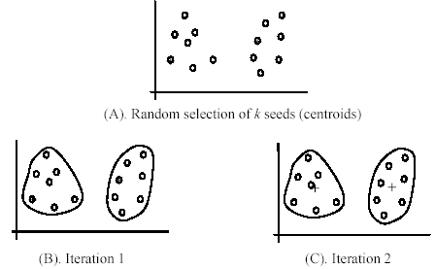
If we use different seeds: good results

Slide 22
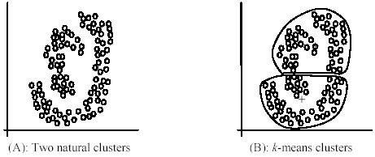
The k-means algorithm is not suitable for discovering clusters that are not hyper-ellipsoids (or hyper-spheres).

Slide 23
Common ways to represent clusters
Use the centroid of each cluster to represent the cluster.
compute the radius and
standard deviation of the cluster to determine its spread in each dimension
The centroid representation alone works well if the clusters are of the hyper-spherical shape.
If clusters are elongated or are of other shapes, centroids are not sufficient

Slide 24
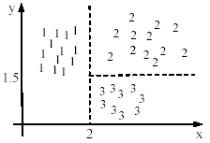

Using classification model
All the data points in a cluster are regarded to have the same class label, e.g., the cluster ID.
run a supervised learning algorithm on the data to find a classification model.
Notes:
k-modes clustering

Slide 25
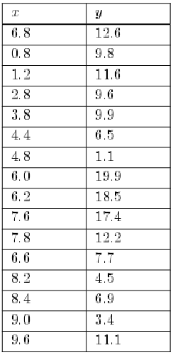
Example
Illustrate the k-means algorithm by using it to cluster the 16 objects with two attributes x and y that are listed =>

Slide 26
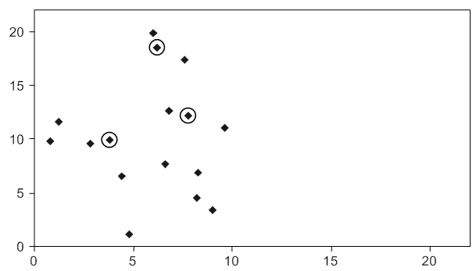
Example
The 16 points corresponding to these objects are shown diagrammatically
The horizontal and vertical axes correspond to attributes x and y, respectively.

Slide 27
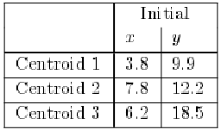
Example Centroids
Three of the points shown in Figure have been surrounded by small circles.
We will assume that we have chosen k = 3 and that these three points have been selected to be the locations of the initial three centroids.
This initial (fairly arbitrary) choice is shown below.

Slide 28
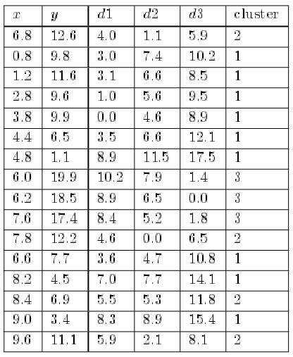

Slide 29
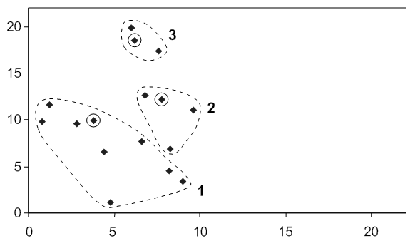

Slide 30
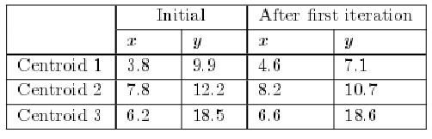
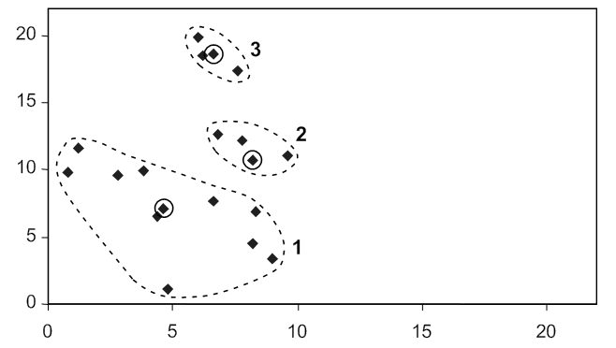

Slide 31
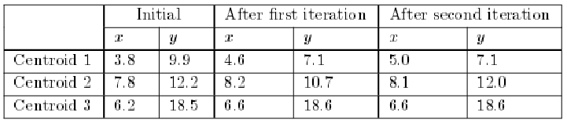
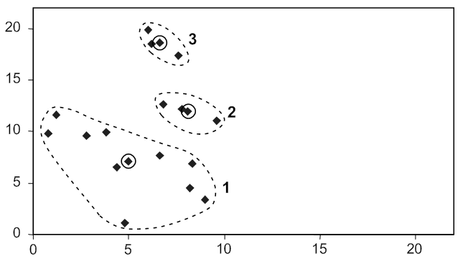

Slide 32
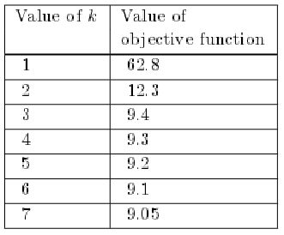
Quality of Clusters
If we imagine choosing k = 1, i.e. all the objects are in a single cluster, with the initial centroid selected in a random way (a very poor idea), the value of the objective function is likely to be large.
We can then try k = 2, k = 3 and k = 4, each time experimenting with a different choice of the initial centroids and choosing the set of clusters with the smallest value.
Notes:
These results suggest that the best value of k is probably 3.
The value of the function for k = 3 is much less than for k = 2, but only a little better than for k = 4.
It is possible that the value of the objective function drops sharply after k = 7, but even if it does k = 3 is probably still the best choice.
We normally prefer to find a fairly small number of clusters as far as possible.

Slide 33
Types of hierarchical clustering
Agglomerative (bottom up) clustering: It builds the dendrogram (tree) from the bottom level, and
merges the most similar (or nearest) pair of clusters
stops when all the data points are merged into a single cluster (i.e., the root cluster).
Divisive (top down) clustering: It starts with all data points in one cluster, the root.
Splits the root into a set of child clusters. Each child cluster is recursively divided further
stops when only singleton clusters of individual data points remain, i.e., each cluster with only a single point

Slide 34
Agglomerative clustering
We start with each object in a cluster of its own and then repeatedly merge the closest pair of clusters until we end up with just one cluster containing everything.
1. Assign each object to its own single-object cluster. Calculate the distance between each pair of clusters.
2. Choose the closest pair of clusters and merge them into a single cluster (so reducing the total number of clusters by one).
3. Calculate the distance between the new cluster and each of the old clusters.
4. Repeat steps 2 and 3 until all the objects are in a single cluster.

Slide 35
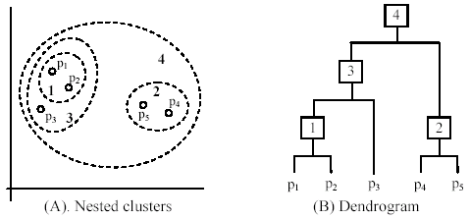
An example: working of the algorithm
If there are N objects there will be N −1 mergers of two objects needed at Step 2 to produce a single cluster. However the method does not only produce a single large cluster, it gives a hierarchy of clusters

Slide 36

Assignment
Develop a program for the two clustering methods and apply on a dataset;
Also visualize the dataset in R.
Measure the complexity empirically.

